Slide 1

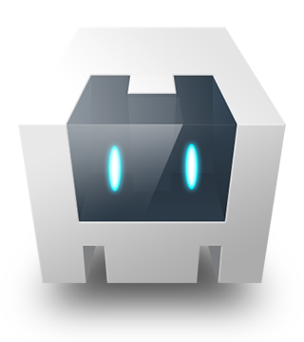
Cordova Plugin Roundup
TJ VanToll | @tjvantoll
Notes:
Thank you very much. I’m super excited to be here at PhoneGap Day. This is my first time in Utah (SLIDE) and, I must say, the state is absolutely gorgeous.

Slide 2
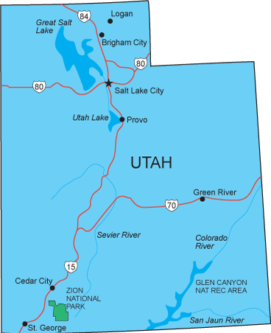
Notes:
And I know a thing or two about gorgeous states because I’m from the lovely state of Michigan (slide).

Slide 3
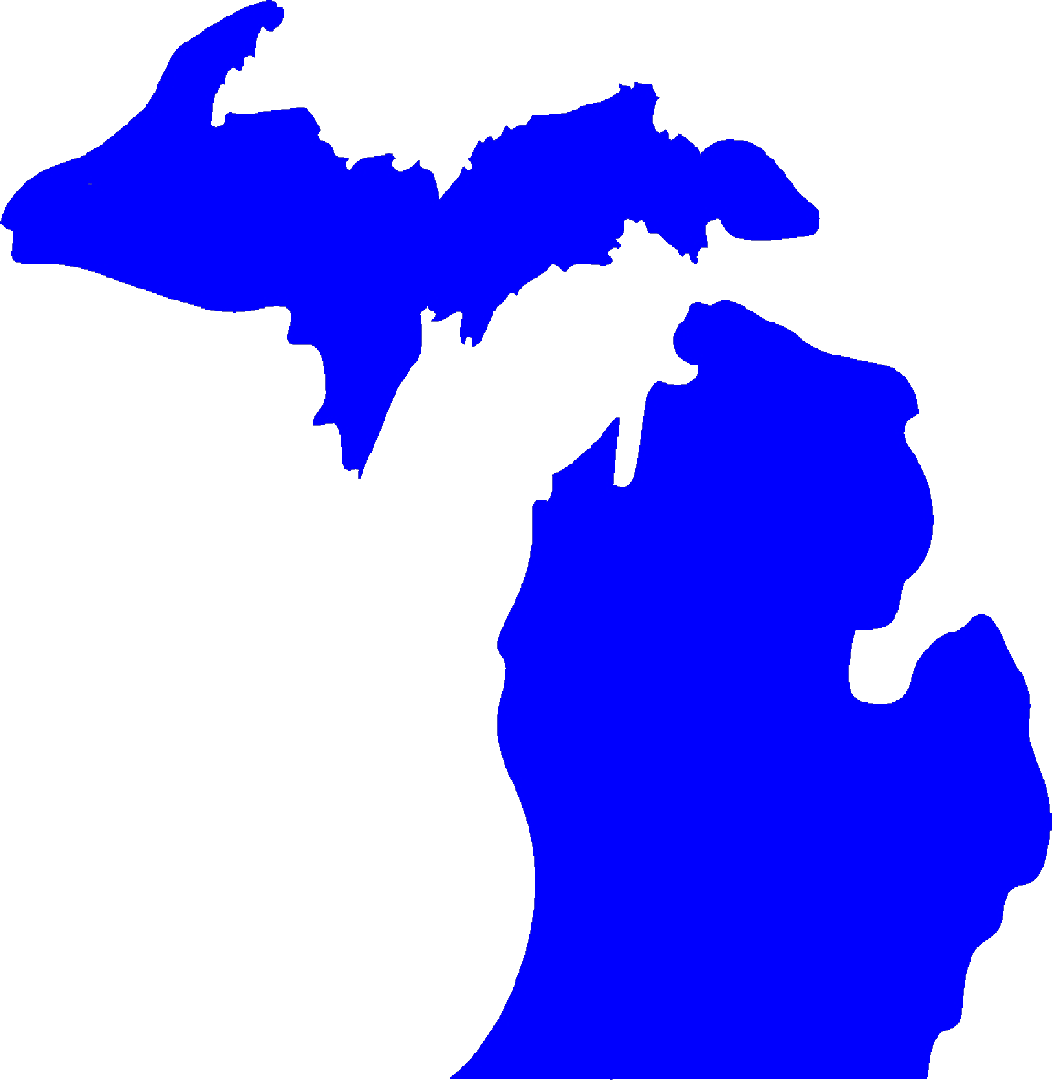
Notes:
So I know you’re all jealous. But ,while I’m here Utah I have to take up a little beef I have with you on behalf of my state. First of all, how many people here are actually from Utah? Come on, own it! Ok, I’m talking to you. Michigan, and this is true…

Slide 4
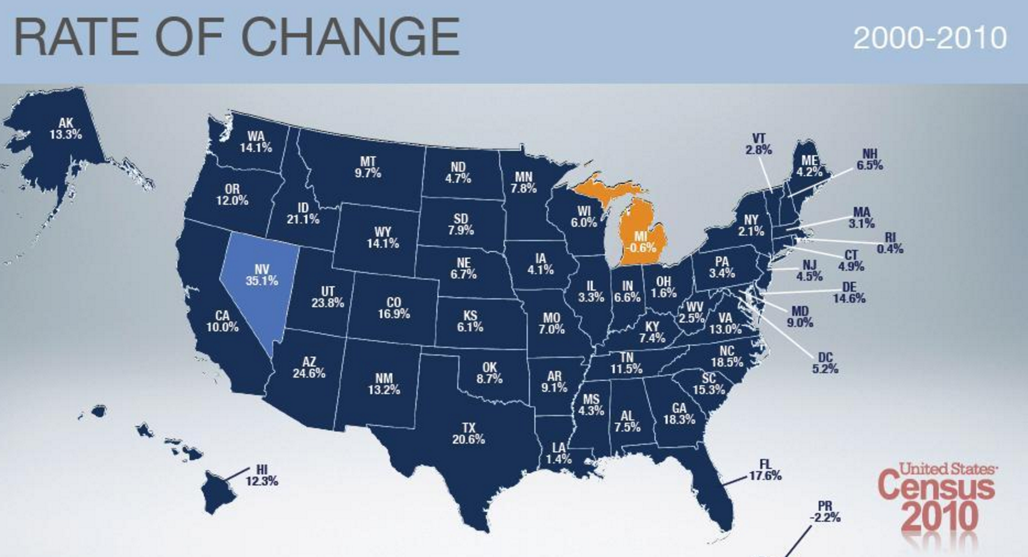
Notes:
was the only state in the country that lost people in the last decade. And if you look closely, it looks like we’re losing a lot of people to your state.

Slide 5
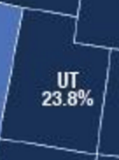
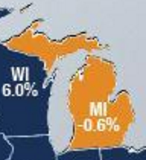
Notes:
My only conclusion is that you, the people of Utah, are using your mountainous wonderland to take people from our state. I mean, I personally can’t think of any other reason (slide) people would leave Michigan.

Slide 6



Notes:
…with our safe, family-friendly neighborhoods and cities. And also our...

Slide 7

Notes:
…and totally-not-corrupt-in-any-way-government officials

Slide 8
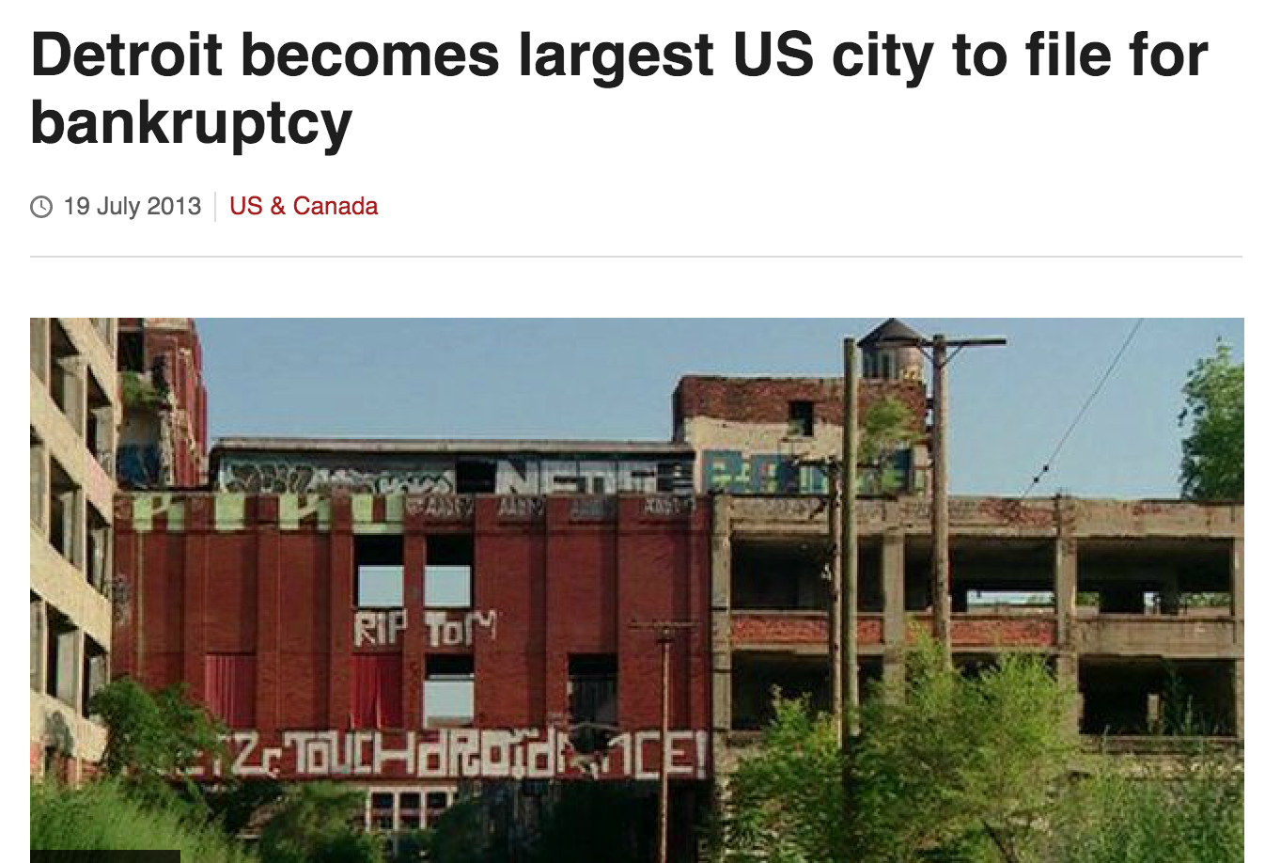
Notes:
...and our sound fiscal responsibility.

Slide 9

Notes:
…and great schools

Slide 10

Notes:
…and succesful sports franchises.

Slide 11
Plugins
Notes:
So stop talking our people Utah, alright. Ok, with that out of the way, let’s move to the _actual_ topic of this talk: Cordova!!!!! And specifically, SLIDE, Cordova plugins

Slide 12


Notes:
I work for a company called Telerik. If you haven’t heard of us before we’re a software company best known for building UI components and really awesome mobile tooling. And, at Telerik we’re big fans of Cordova, and specifically we happen to be big fans of Cordova plugins. (slide)
We believe Cordova plugins are what make hybrid apps, well, hybrid. The best hybrid apps, at least in my opinion, are ones that not only leverage the best from the web has to offer, but also the best that native ecosystems do too.

Slide 13
Cordova Plugin Problems
Plugins are hard to build.
Plugins are hard to maintain.
Notes:
When we first started building Cordova tooling several years ago though, we found that there it was really hard to find high-quality third-party Cordova plugins.
And I think there are a few reasons for that. First of all Cordova plugins are kind of hard for web developers to build (SLIDE)

Slide 14
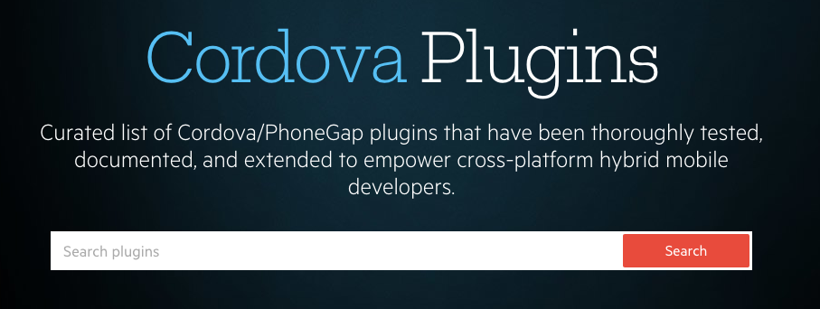
http://plugins.telerik.com/cordova
Notes:
And in an attempt to help that situation, we at Telerik , about two years ago, launched what we call the Telerik Verified Plugin Marketplace, which you can find at plugins.telerik.com/cordova.
The goal of the marketplace was to provide a consolidated place that our customers, and the Cordova community, could go to find plugins that you could feel confident that they’d work in your apps.

Slide 15
Each plugin is…
Open Source
Free
Documented
Verified

Slide 16
Telerik Verified Plugins Marketplace
67 plugins and counting!
Over 100,000 plugin downloads!

Slide 17
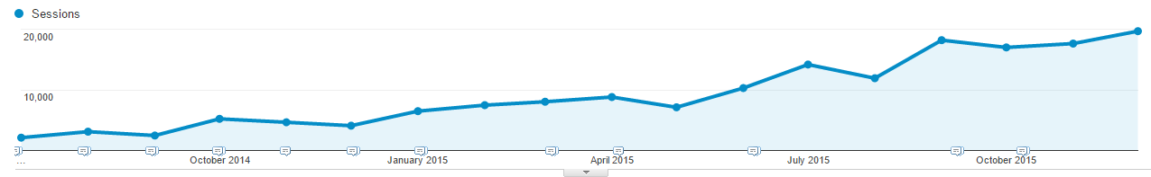
Telerik Verified Plugins Marketplace
5x increase in traffic (4,000 → 20,000 sessions) over the last year

Slide 18
<plugin-roundup>
Notes:
Let’s—SLIDE—get started.

Slide 19
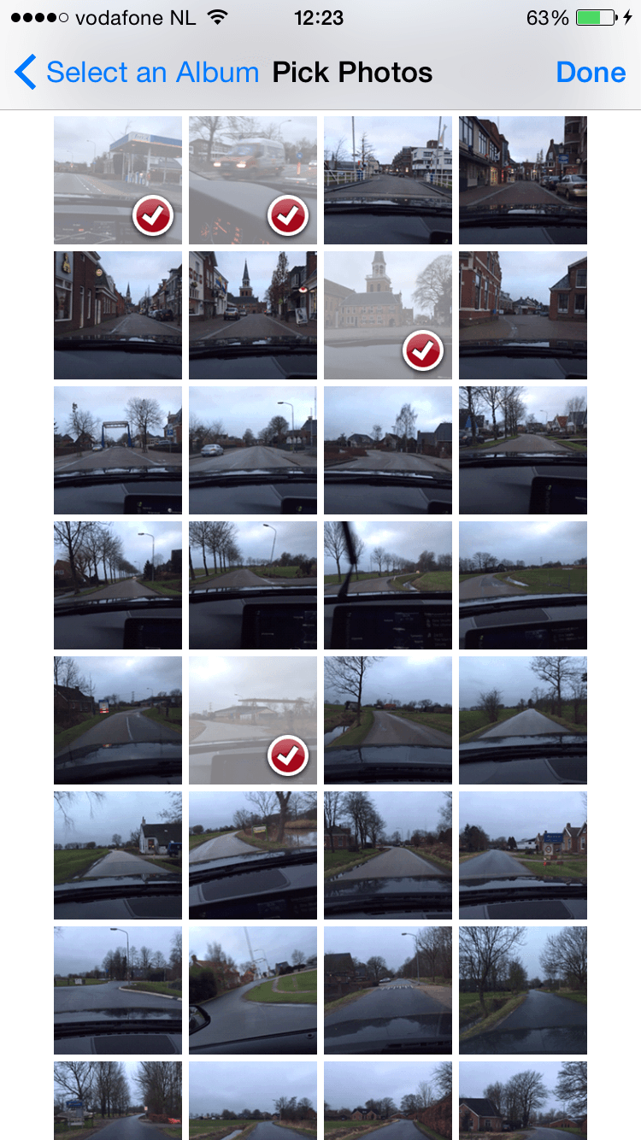
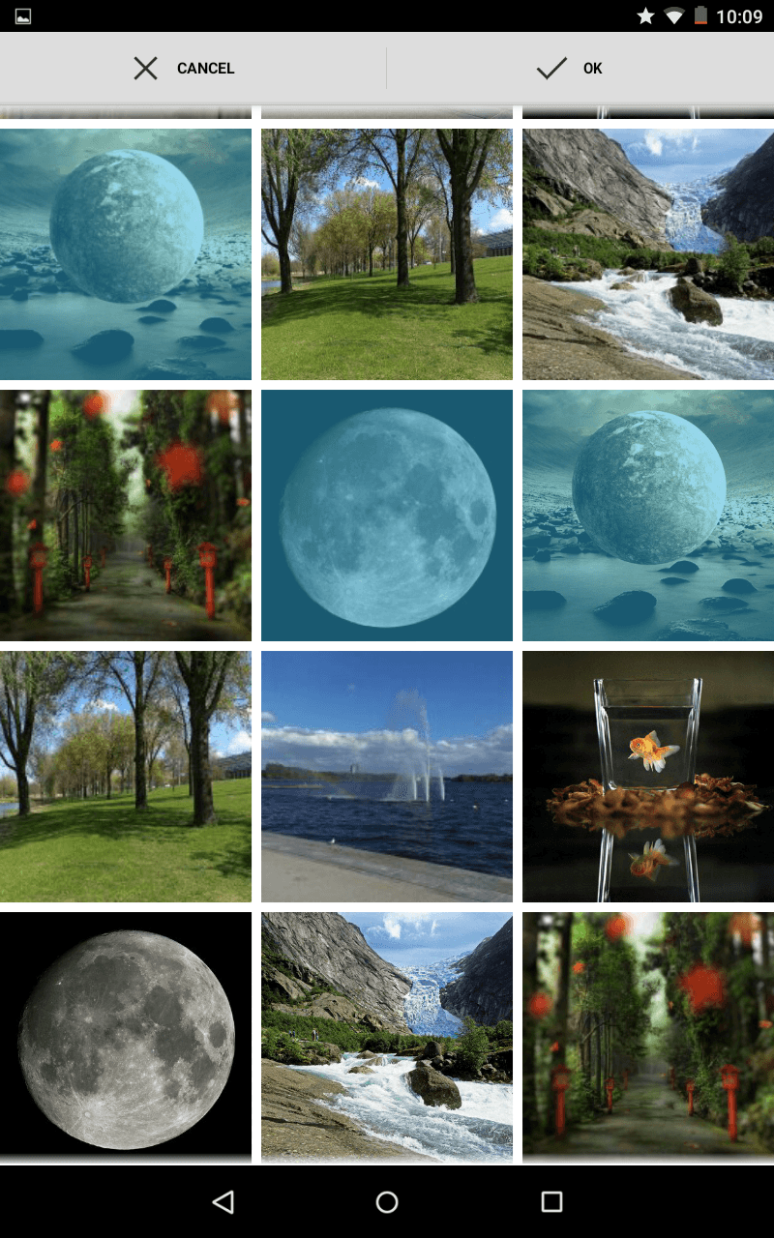

Plugin #1: ImagePicker

Slide 20
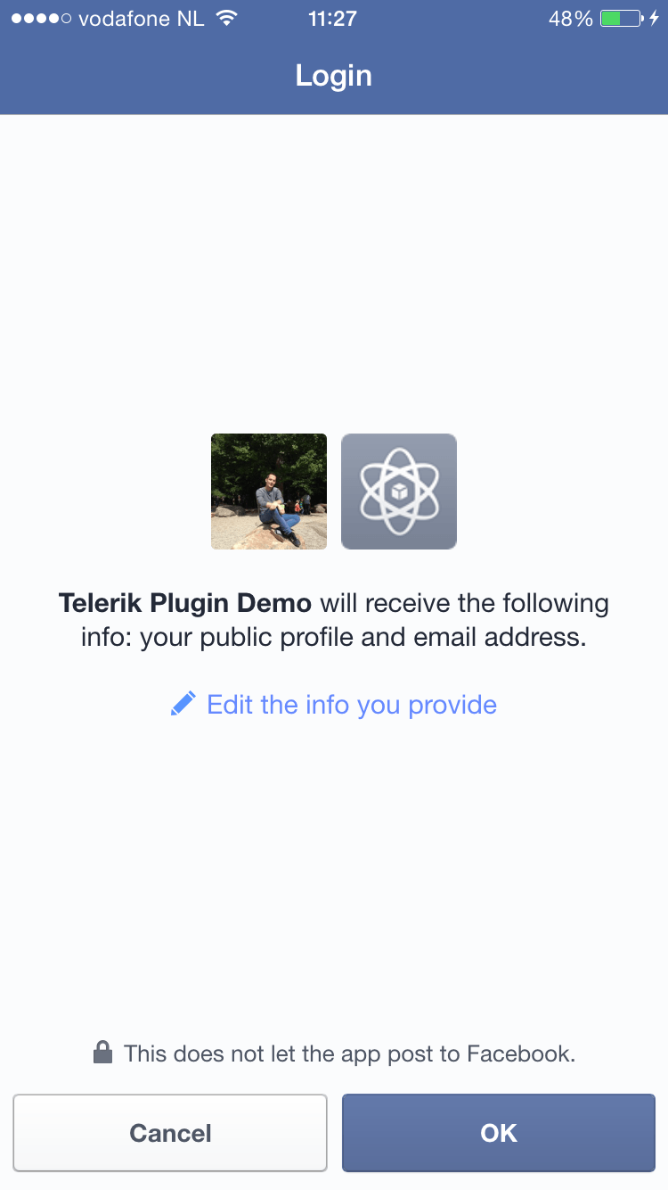
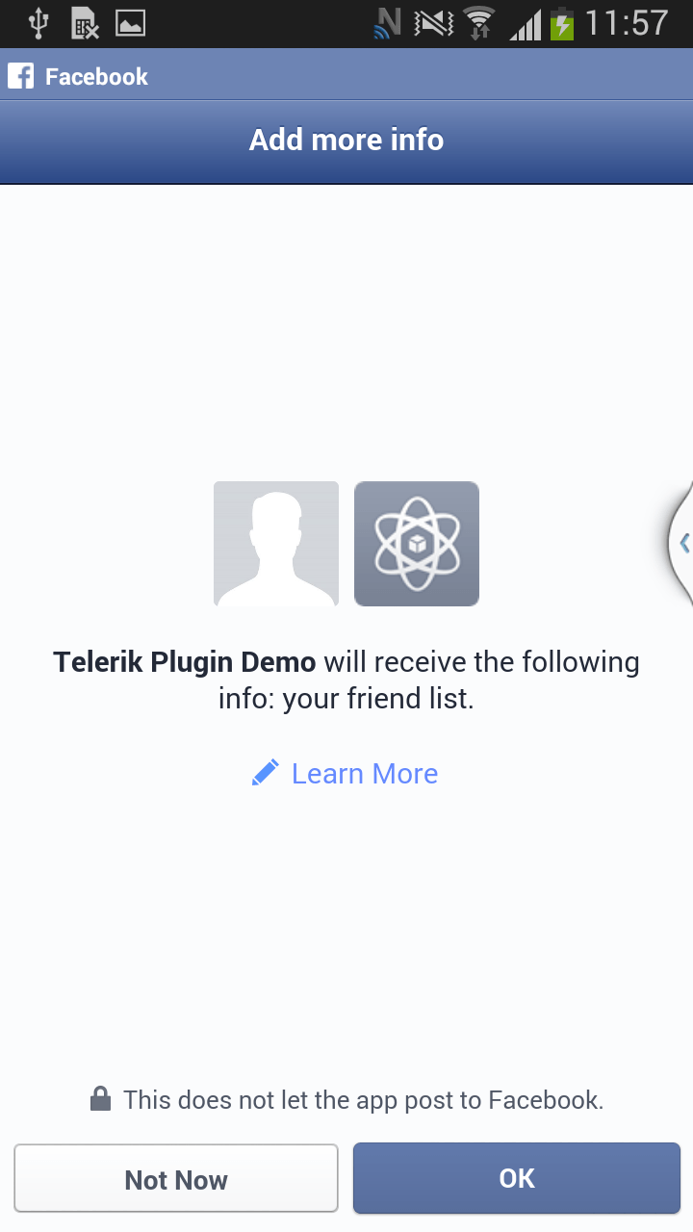

Plugin #2: Facebook

Slide 21
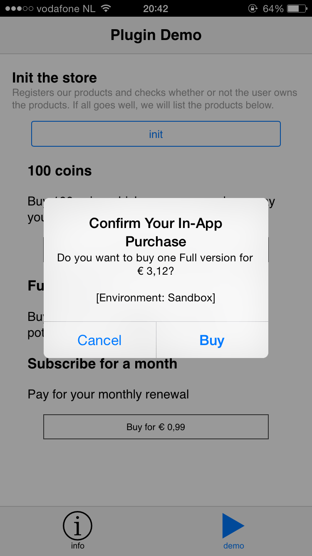
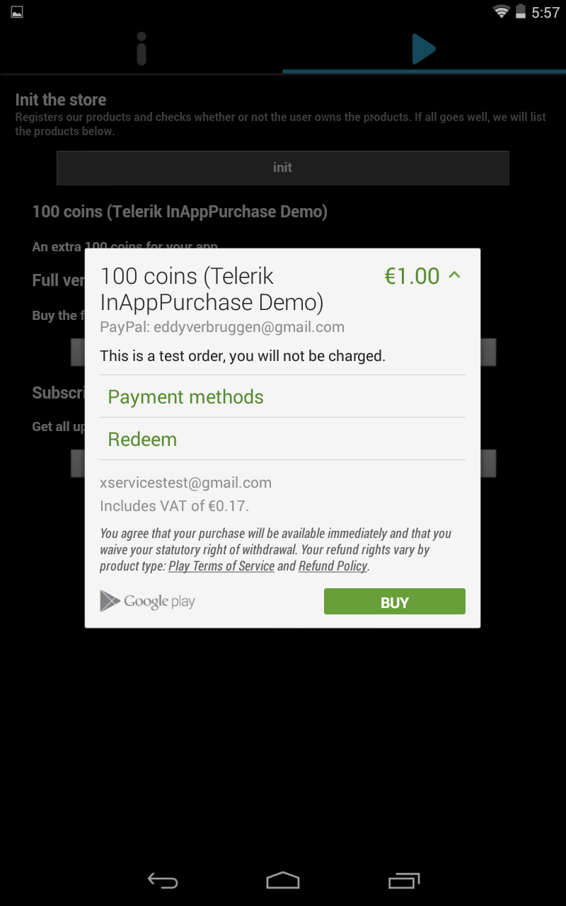

Plugin #3: InAppPurchase

Slide 22
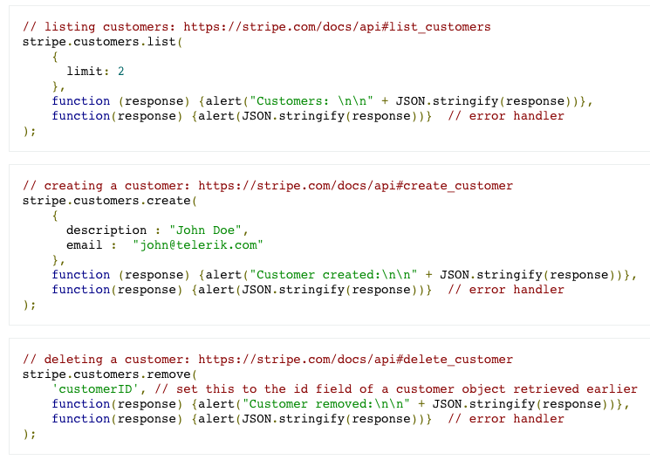
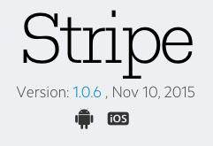
Plugin #4: Stripe

Slide 23
Where do the plugins come from?
Some are community written
Some are Telerik written
Notes:
Let’s take a small break from the roundup because I want to answer another common question we get, and that’s: where do these plugins come from?
But, there’s one common theme that runs throughout the marketplace, and that theme is this guy (slide)

Slide 24

Eddy “The Plugin” Verbruggen
Notes:
How many people know who this is? Exactly. This is Eddy Verbruggen, aka Eddy “The Plugin” (SLIDE), who is our resident plugin jedi master. When I was putting together this roundup, actually, I just happened to notice that the last six plugins were at least originally authored by Eddy.
Now I really wanted a picture of Eddy in a superhero costume for this slide deck, because I just thought it would be appropriate, but since I don’t have one of those I’m going with the best I have….

Slide 25

Notes:
Which is this picture, which I think works pretty well actually. Particularly well, because…

Slide 26
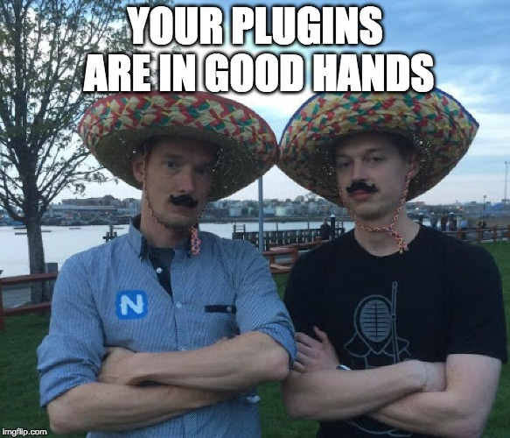
Notes:
I’m in it too. I’ll let you make up your own story for how this picture came to be, but for now let’s go back to plugins.

Slide 27
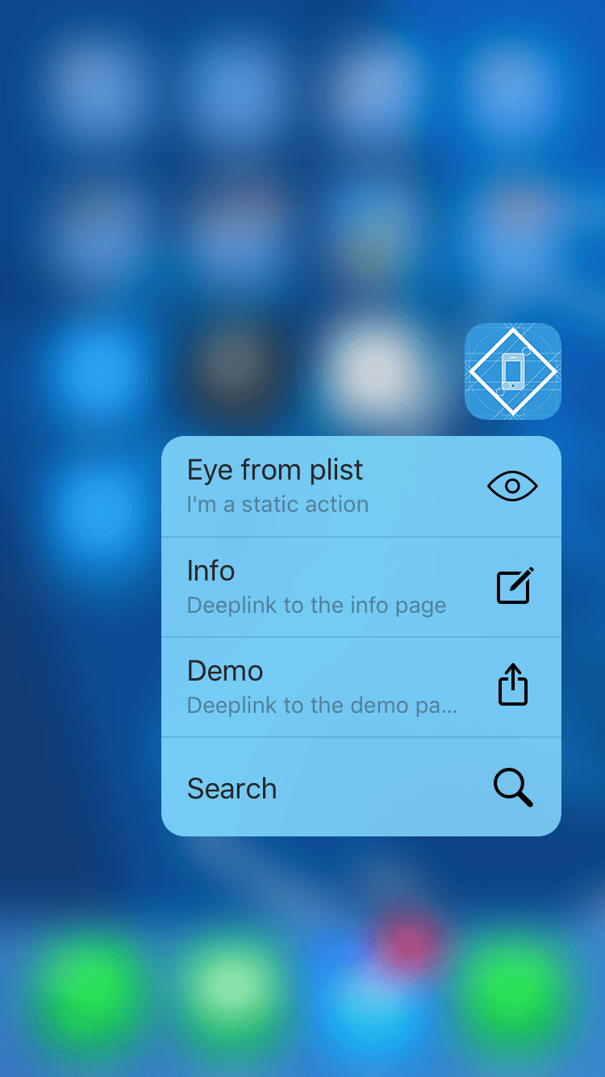


Plugin #5: 3D Touch

Slide 28
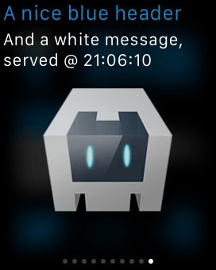
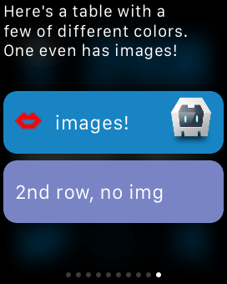

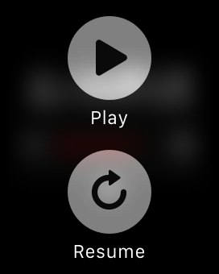
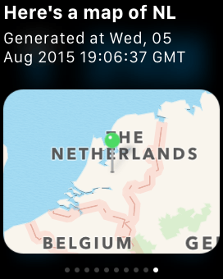
Plugin #6: Apple Watch
Notes:
Which is actually the coolest plugin I think we have from an engineering perspective. What Eddy’s plugin actually does is scaffold an Apple Watch app with a bunch of hidden UI components, and then gives you a JavaScript API that programmatically shows those elements—you can even do glances and interactive notification, for those of you familiar with arcane Apple Watch terminology.
If you’re interested check out the plugin on the marketplace. The docs are really thorough about how the plugin works and all the things you can do.

Slide 29
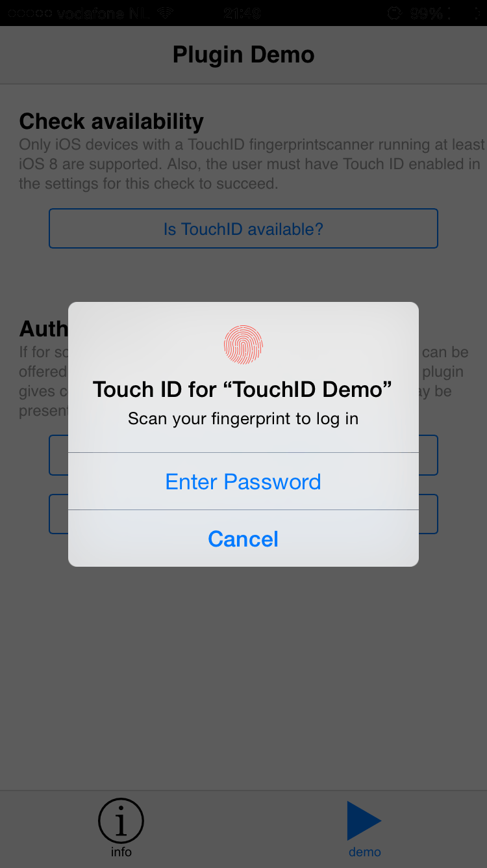

Plugin #7: Touch ID

Slide 30
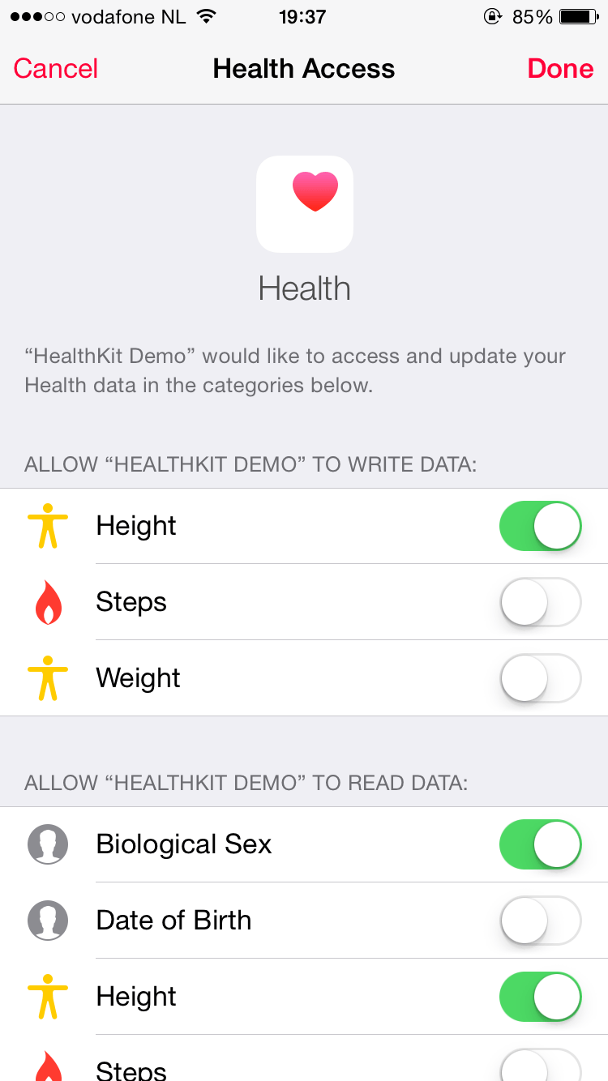

Plugin #8: HealthKit

Slide 31
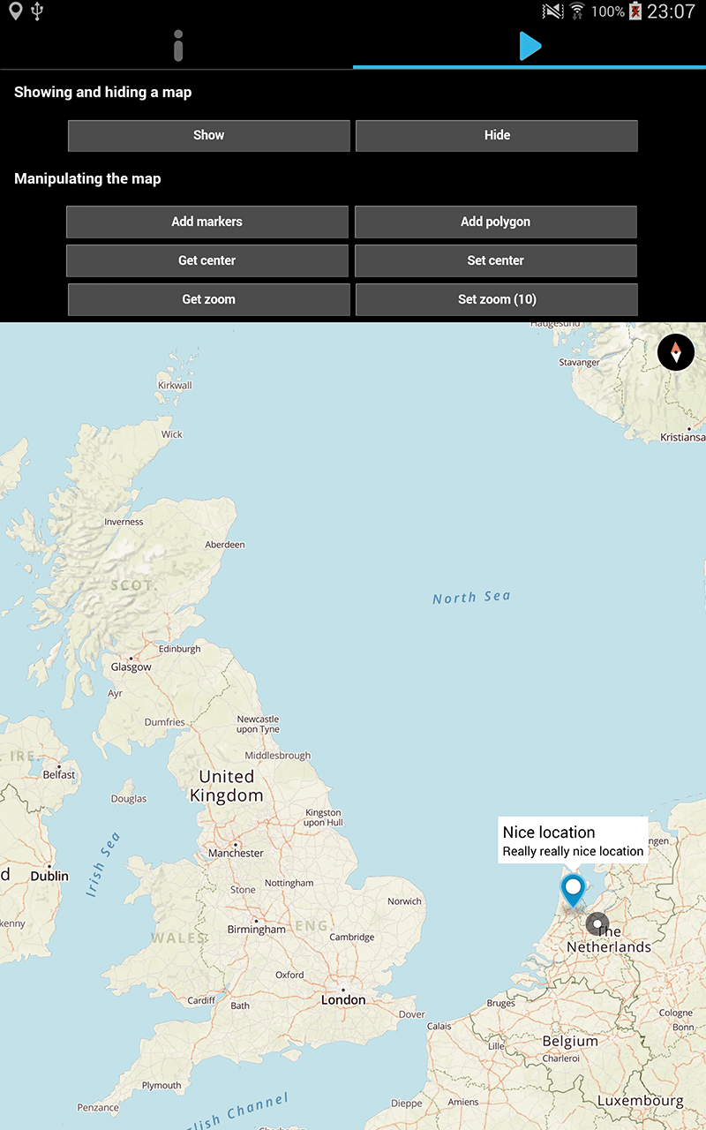
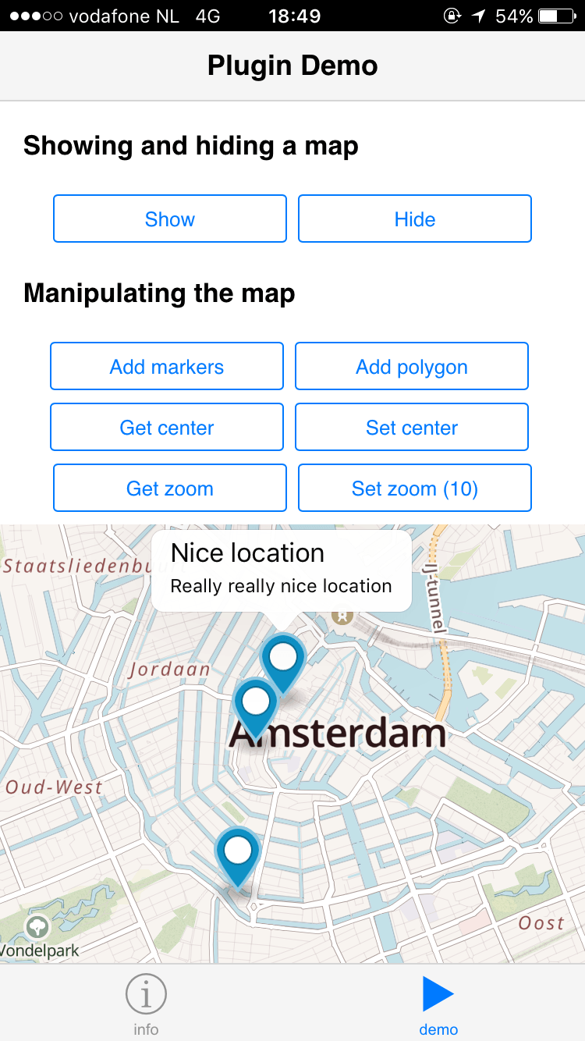
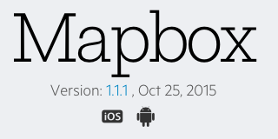
Plugin #9: Mapbox

Slide 32

Plugin #10: Native Page Transitions

Slide 33
</plugin-roundup>
Notes:
And that concludes our plugin roundup. Hopefully you saw a few plugins that you might want to use in your projects. Remember that we only looked at 10 out of 67 plugins, so make sure to check out the marketplace, If you aren’t already doing so.

Slide 34
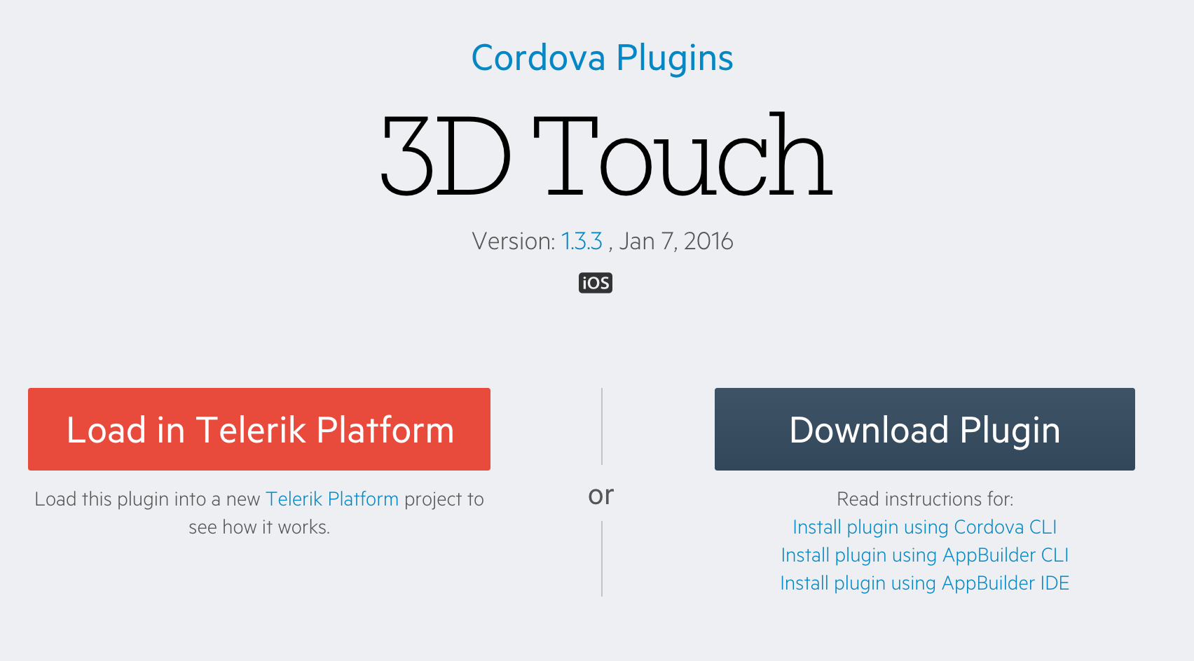
Notes:
When you go to the marketplace and you click on a plugin you’ll find that there are two buttons.
One just downloads the plugin’s source—remember that all of these plugins are free and open source... (SLIDE)

Slide 35
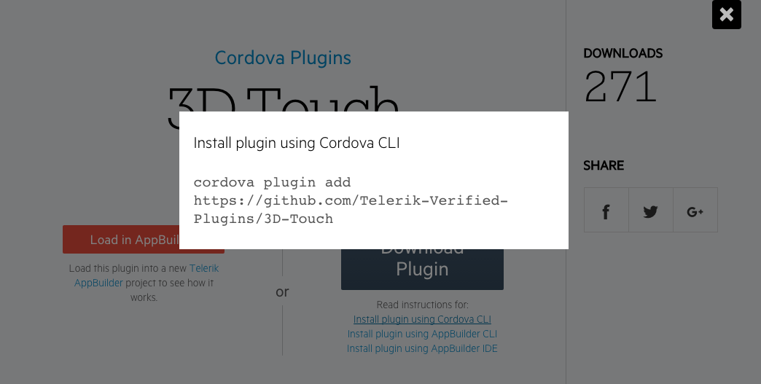
Notes:
We also provide instructions for using plugins with the Cordova CLI as well.

Slide 36
Notes:
The other button automatically loads the plugin into a live app in the Telerik Platform, which is our mobile development suite.
If you haven’t heard of the Telerik Platform, we consider it to be everything you need to build high-quality Cordova apps. That includes plugin tools like…

Slide 37
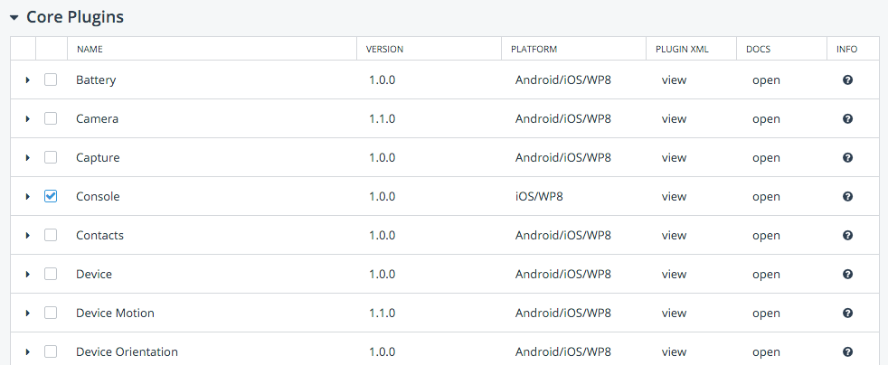
Telerik AppBuilder
Notes:
A UI for managing your plugins, which was one of the tips actually mentioned earlier.

Slide 38
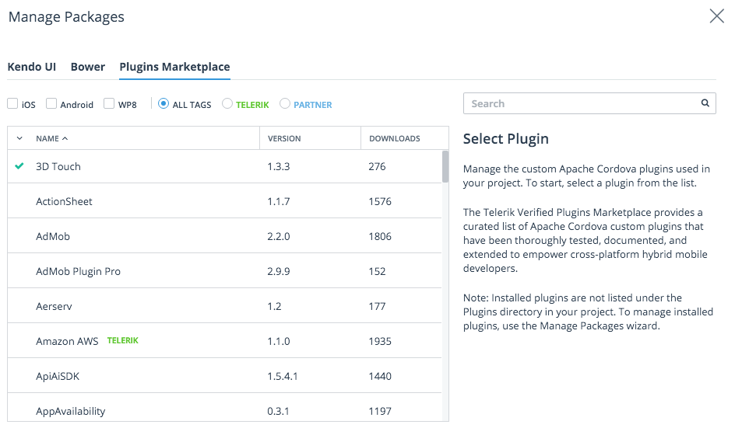
Telerik AppBuilder

Slide 39
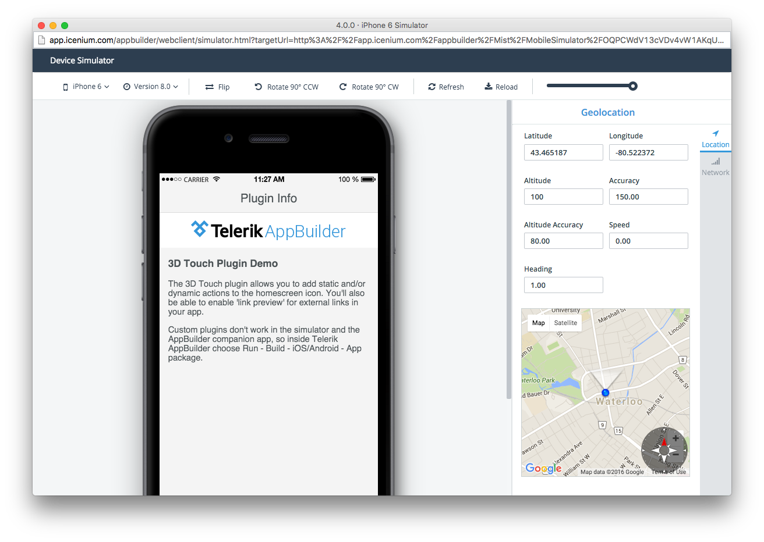
Telerik AppBuilder

Slide 40
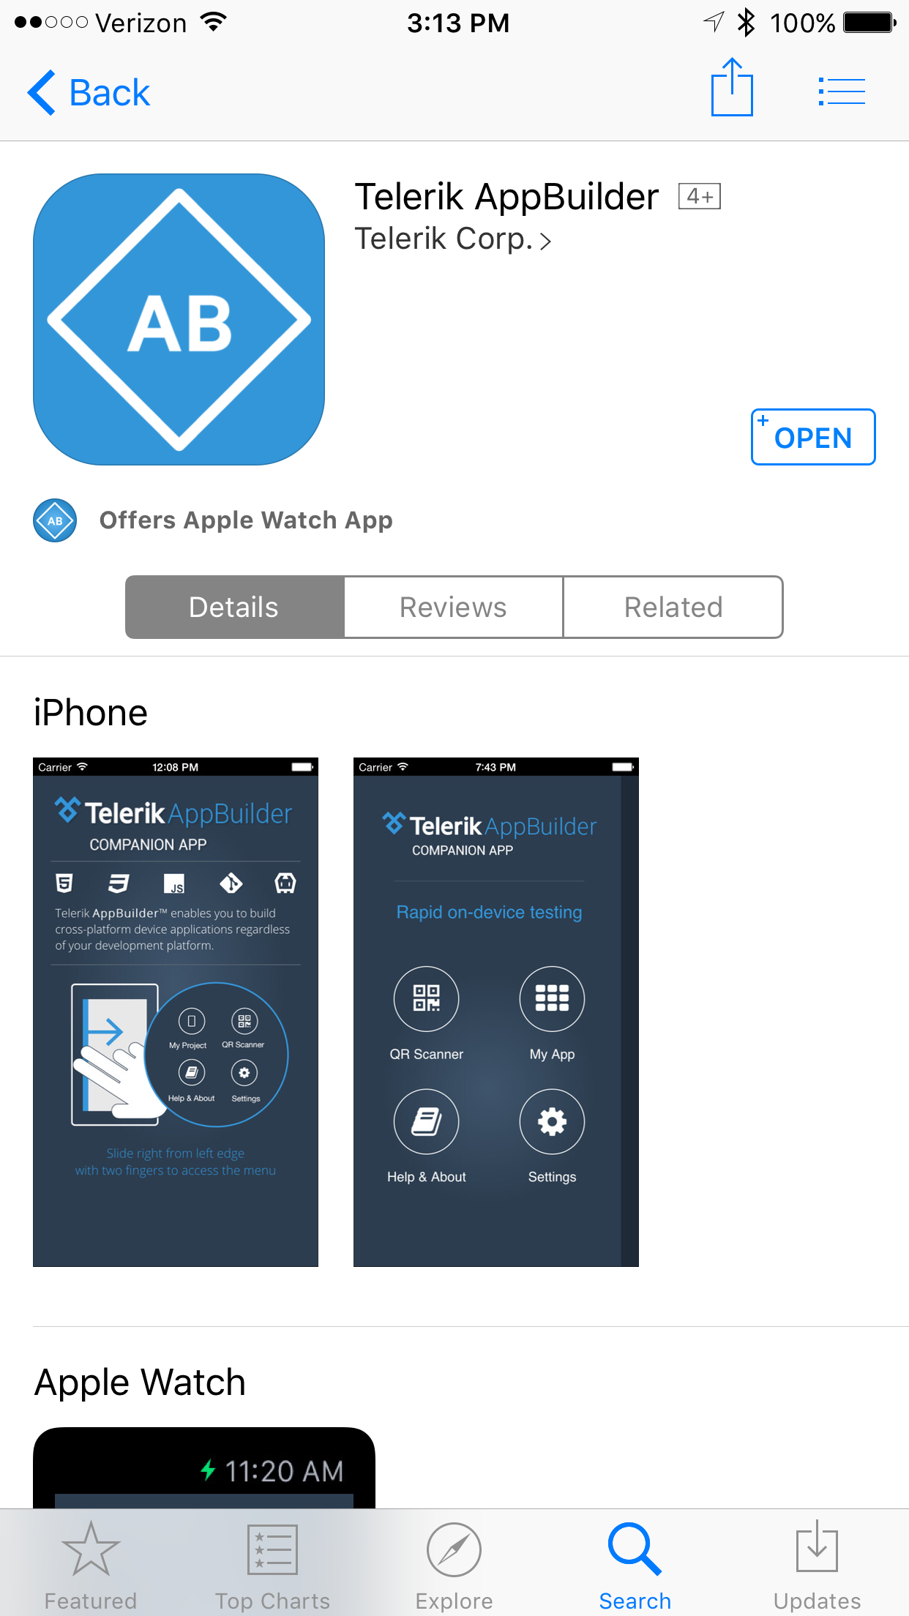
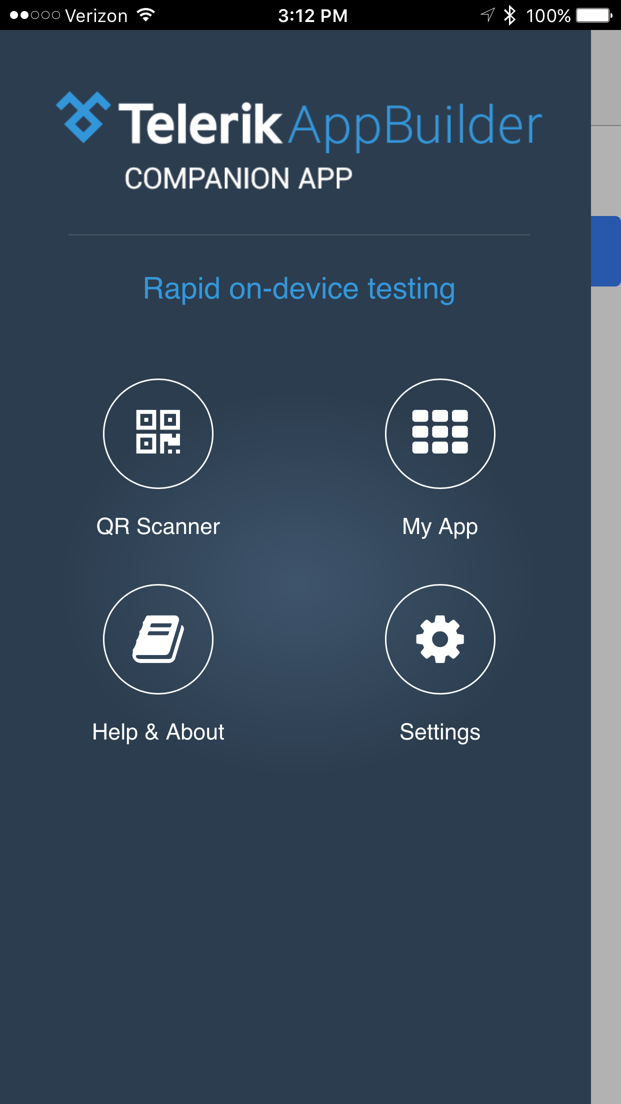
Telerik AppBuilder

Slide 41
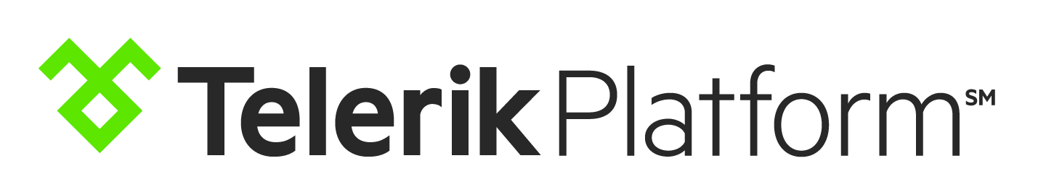
Simulators
App management
Data storage
User management
Push notifications
Email notifications
Team management
Visual prototyper
Companion apps
Deployment tools
Notes:
And all sorts of other things as well—including app management, push notifications, and a whole lot more.

Slide 42
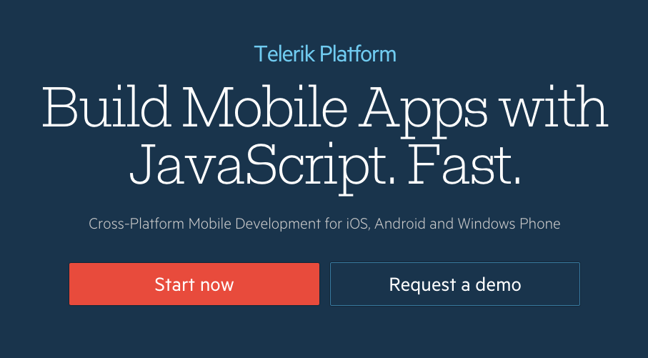
https://telerik.com/platform
Notes:
If you’re interested head to telerik.com/platform. Everyone gets a free 30-day trial, so try it out, and see if it makes sense for you or your team for your next project.

Slide 43
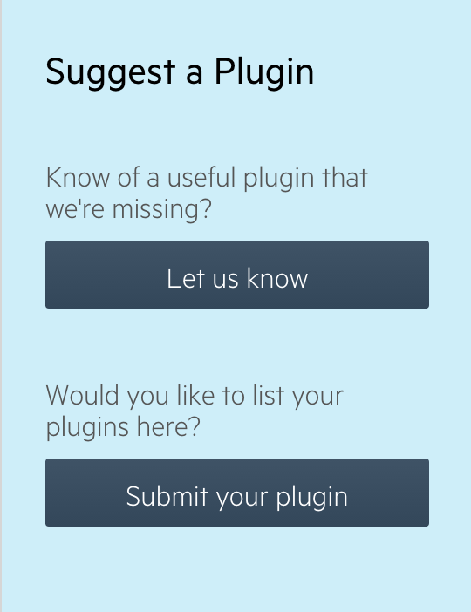
http://plugins.telerik.com/cordova

Slide 44
Thanks!
TJ VanToll | @tjvantoll
Notes:
PLUG THE FUCKING AMAZON ECHO

